Slide 1
Customer Retention Case Study

Slide 2
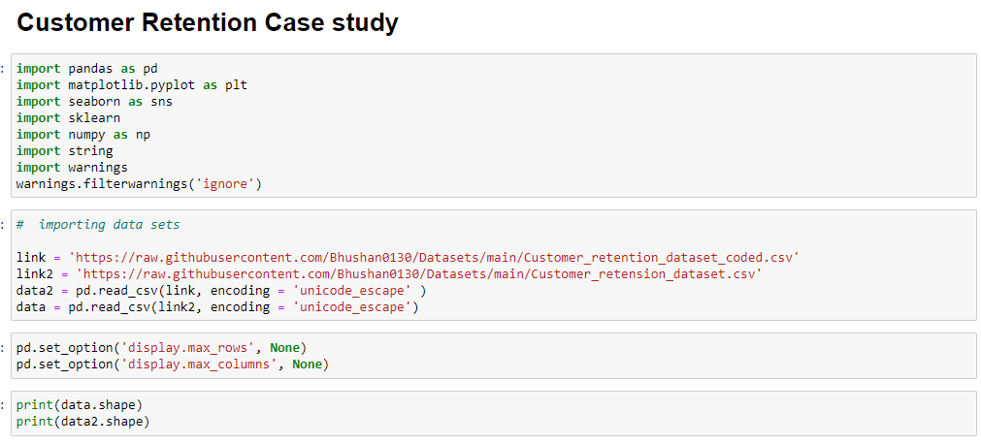

Slide 3
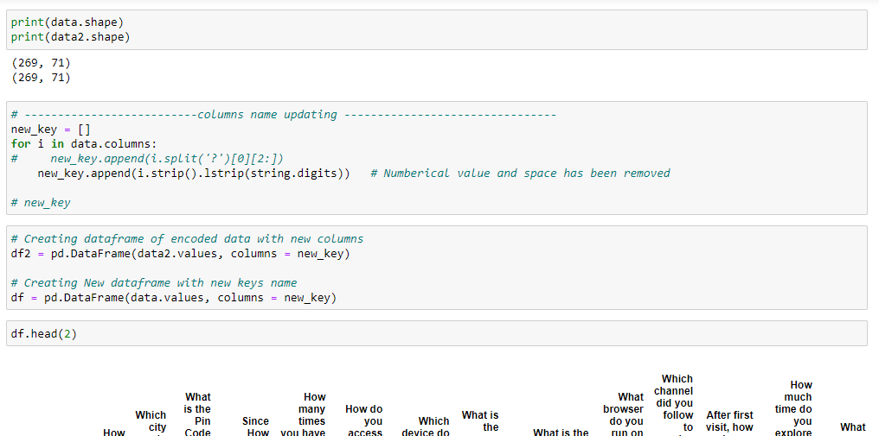

Slide 4
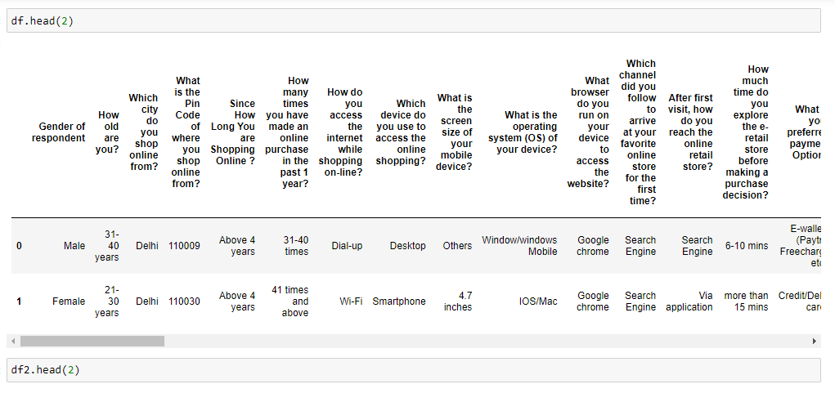

Slide 5
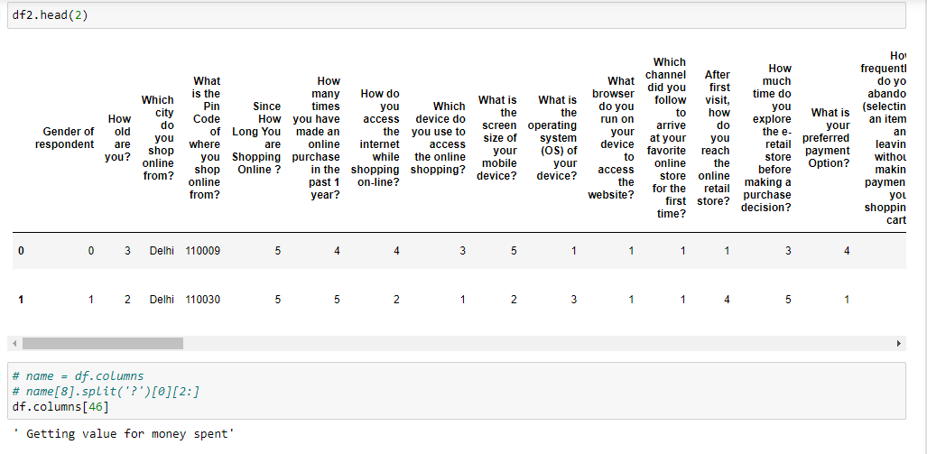

Slide 6
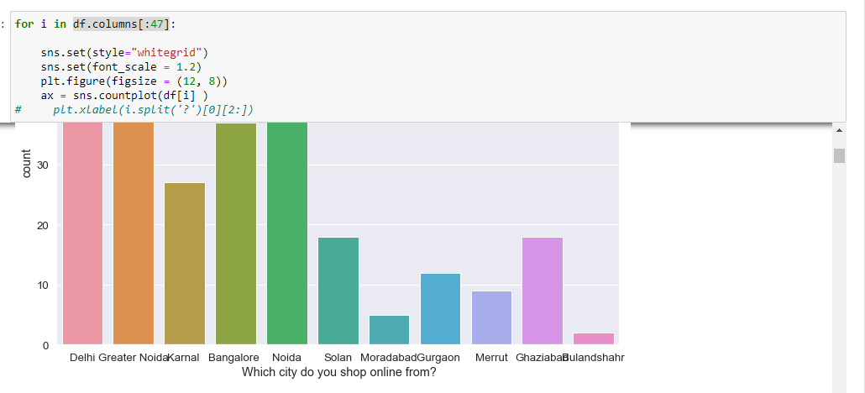

Slide 7
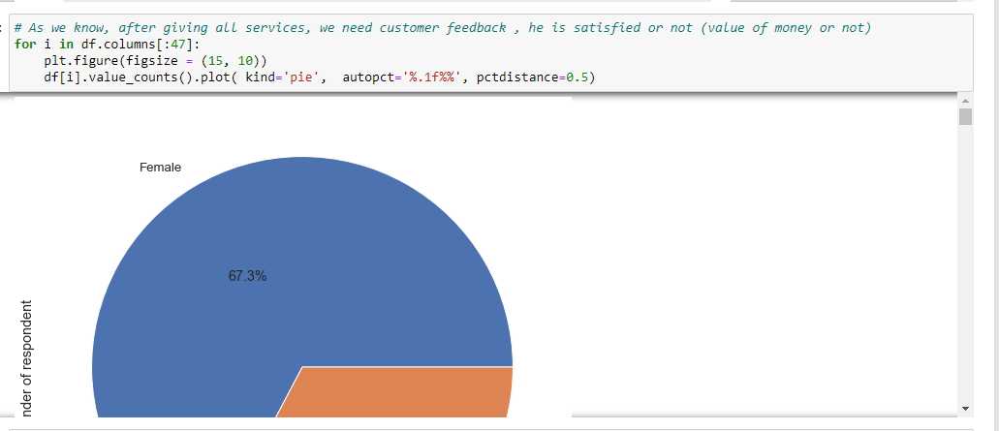

Slide 8
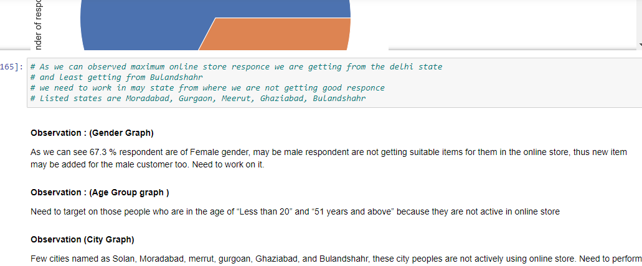

Slide 9
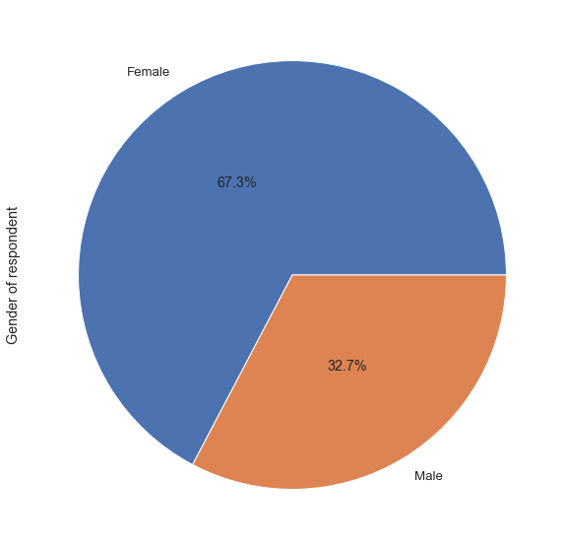
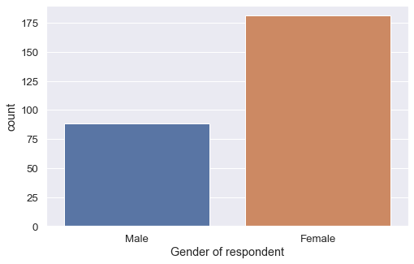
Observation :
As we can see 67.3 % respondent are of Female gender, may be male respondent are not getting suitable items for them in the online store, thus new item may be added for the male customer too.
Need to work on it.

Slide 10
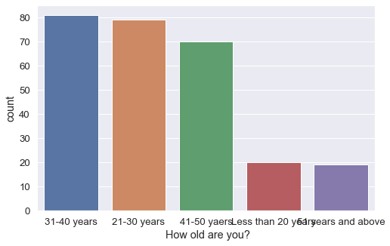
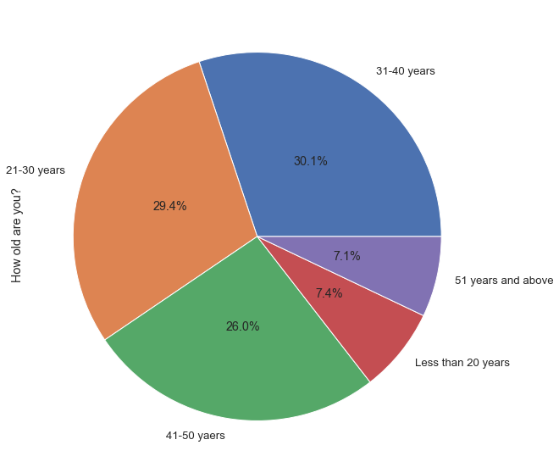
Observation:
Need to target on those people who are in the age of “Less than 20” and “51 years and above” because they are not active in online store

Slide 11
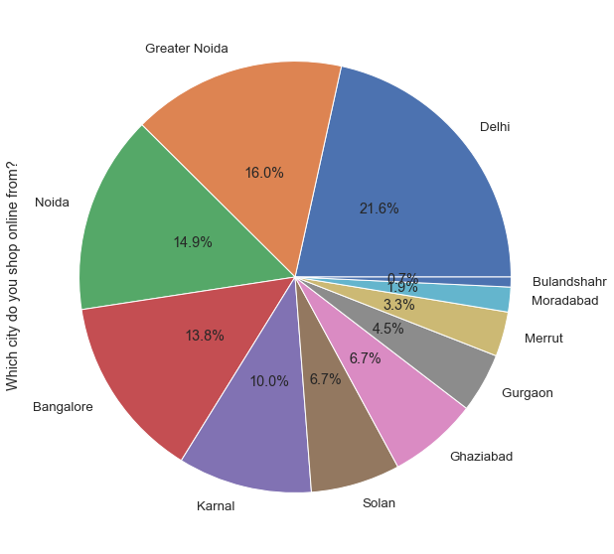
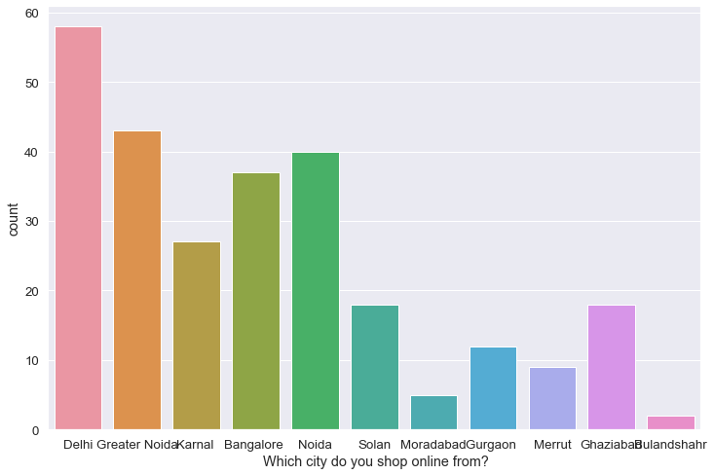
Observation:
Few cities named as Solan, Moradabad, merrut, gurgoan, Ghaziabad, and Bulandshahr, these city peoples are not actively using online store.
Need to perform marketing tricks to these cities to increase customer

Slide 12
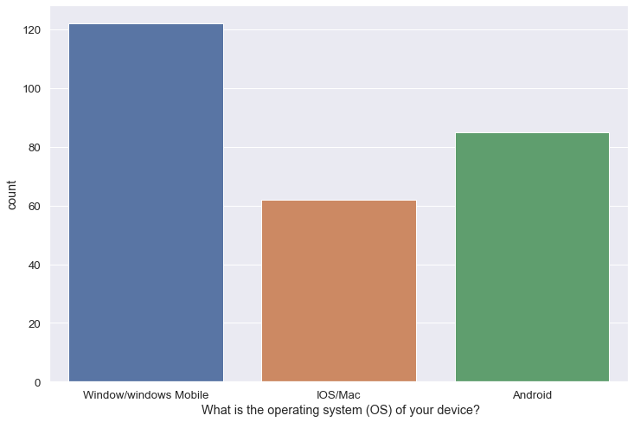
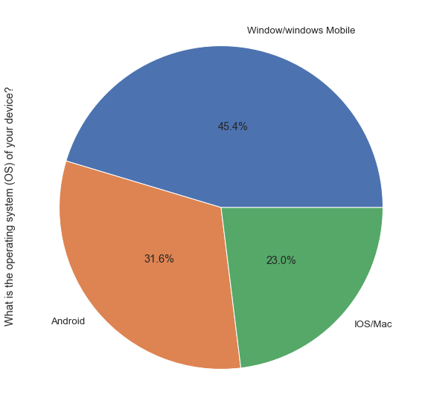
By this visualization we can conclude that majority of people are using Window/Window mobile
Only 23.0 % people are using IOS/Mac by which we can say, IOS/MAC is less active in market

Slide 13
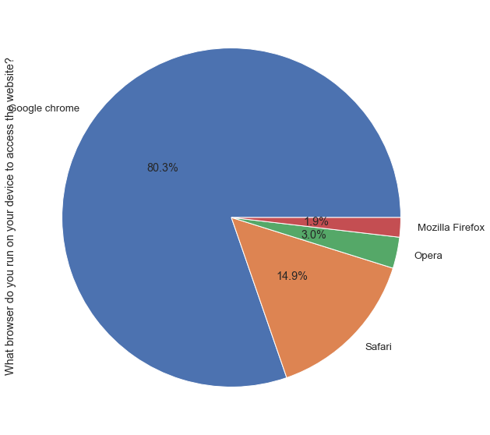
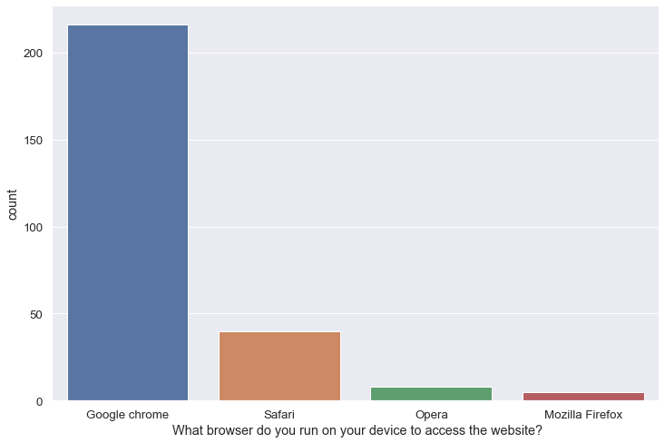
Observation :
Majority of people are using Google Chrome, mean Chrome is in high trend because of its performance.
As Mozila Firefox user are very less, which mean it is about too demolish if its owner will not increase its performance.

Slide 14
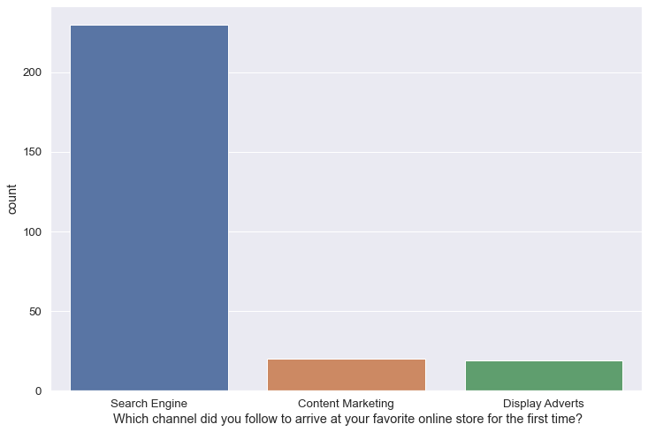
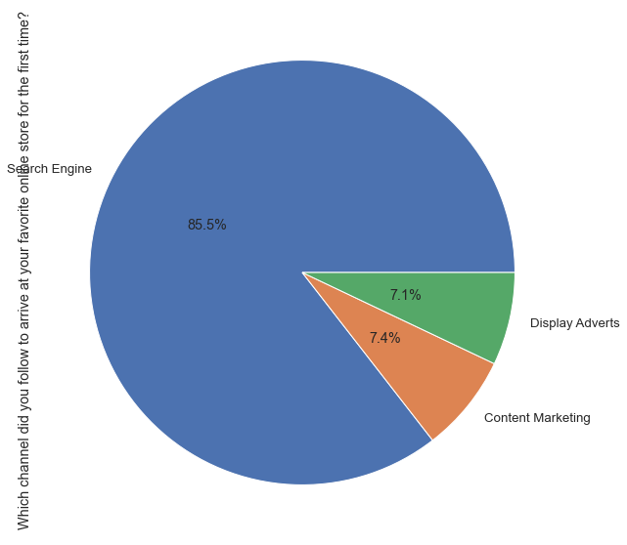
Observation :
As per observation “Search Engine” is the only way of market which can give use high result, because maximum users are coming online shop through Search engine wayts performance.
Content marketing and Display adverts are also contributing to increase customer in almost equal percentage

Slide 15
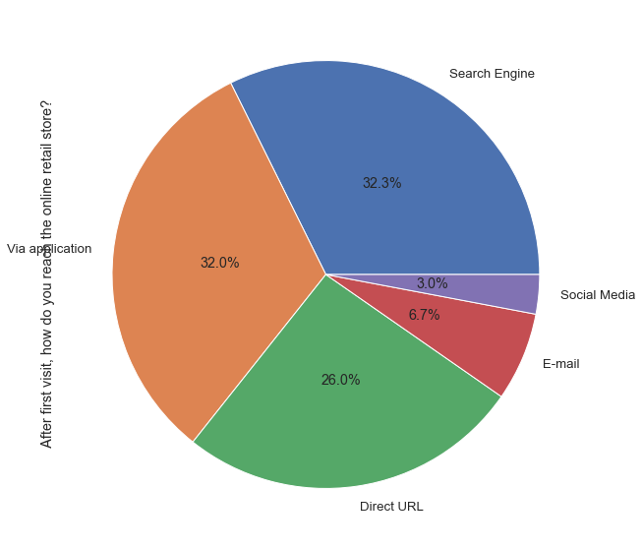
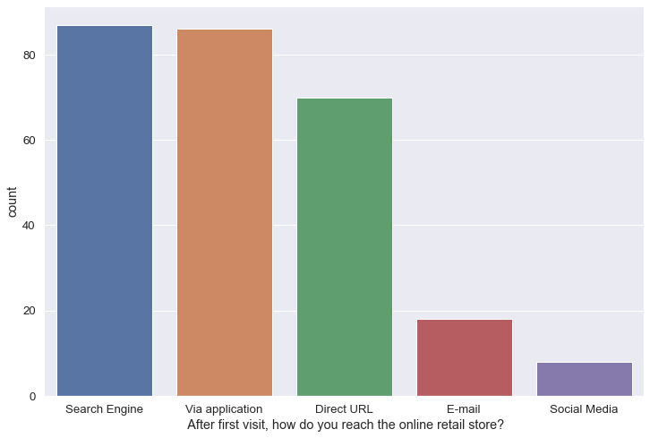
Observation :
After visiting first time, main source to reach website is search engine, via application and Direct URL, therefore we can say we should focus on these way of marketing to growth online store

Slide 16
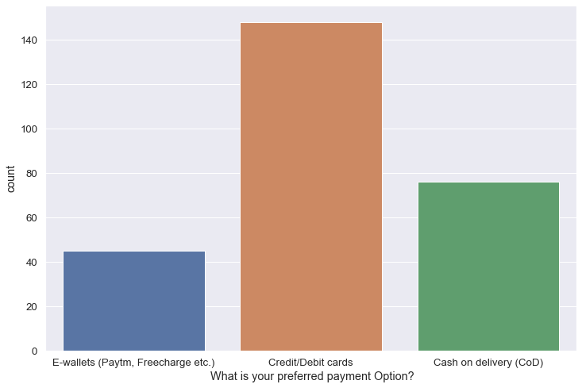
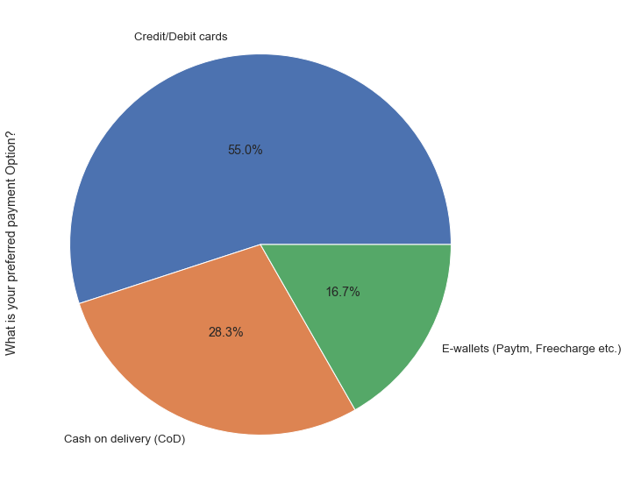
Observation :
Majority of People are using Credit/Debit card method to make payment, which tell us that many people are still are not enough familiar with other mode of payment

Slide 17
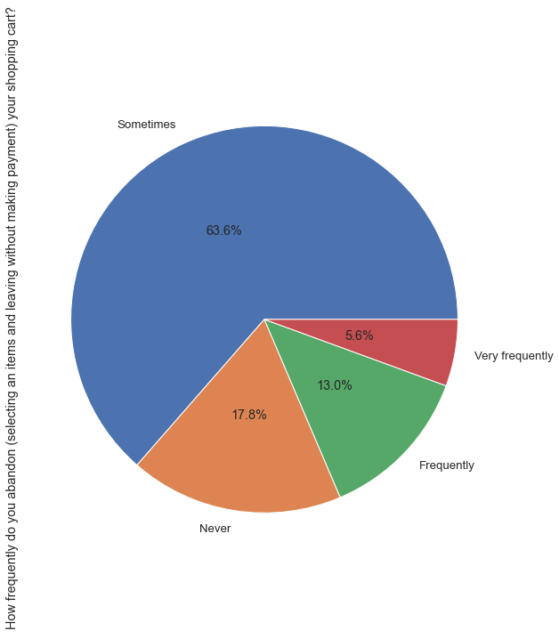
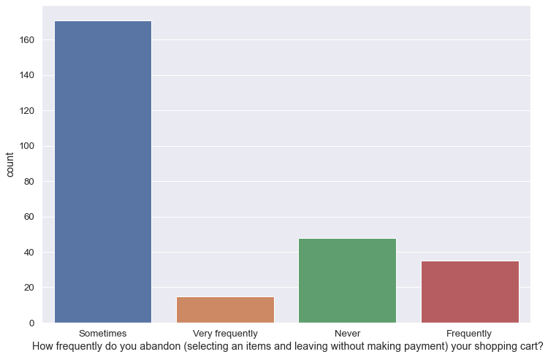
Observation :
1. Major of people are doing this thing only sometimes, which can be done by mistake or by some other reason
2. We need to look on 5.6 (Very Frequently) and 13 % (Frequently) this might be because of some problem, we should think toward to fix it.

Slide 18
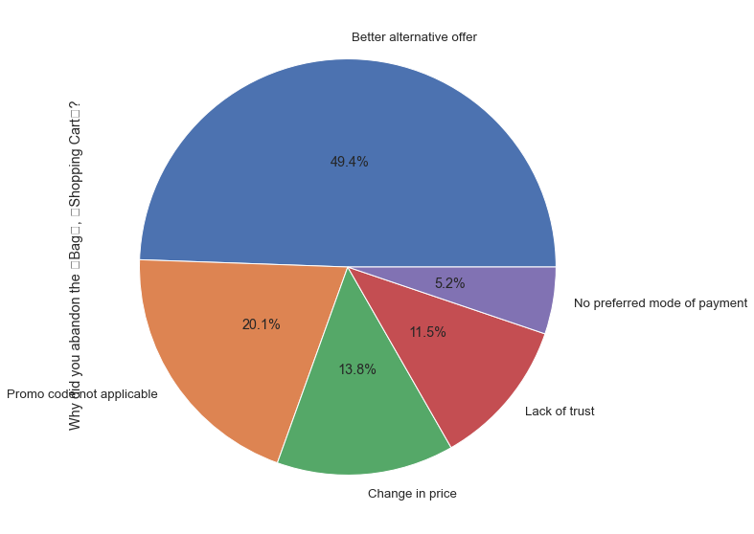
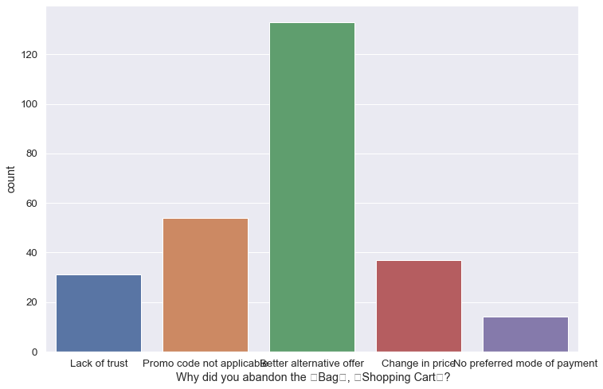
Observation :
Maximum people are abandon the bag because they are getting better alternative offer.
5.2 % are those people are abandoning the bag because they are not getting proffered mode of payment

Slide 19
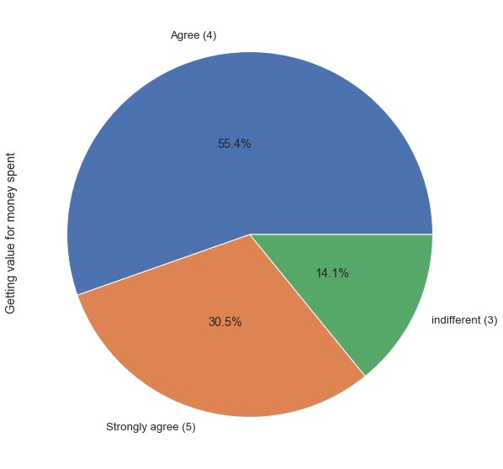
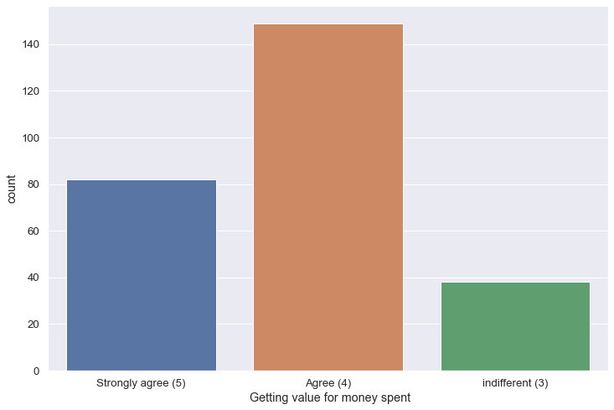
Observation :
As we know for every business customer satisfaction is on priority, and in this visualization we can see only 14.1% customer are indifferent (not satisfied).
Majority is favoring this online store.

Slide 20
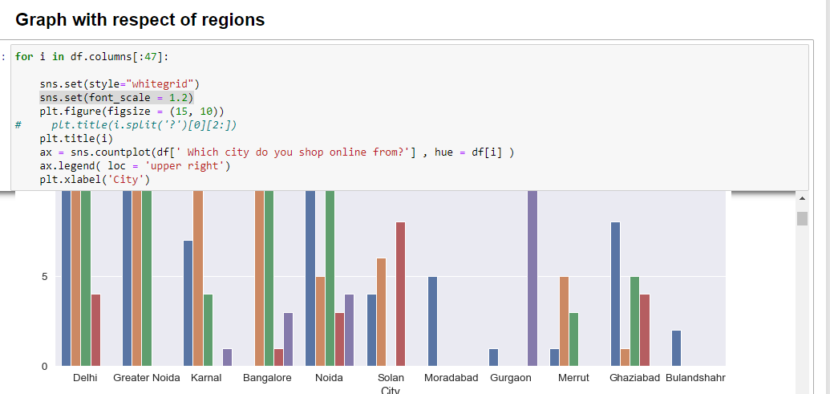

Slide 21
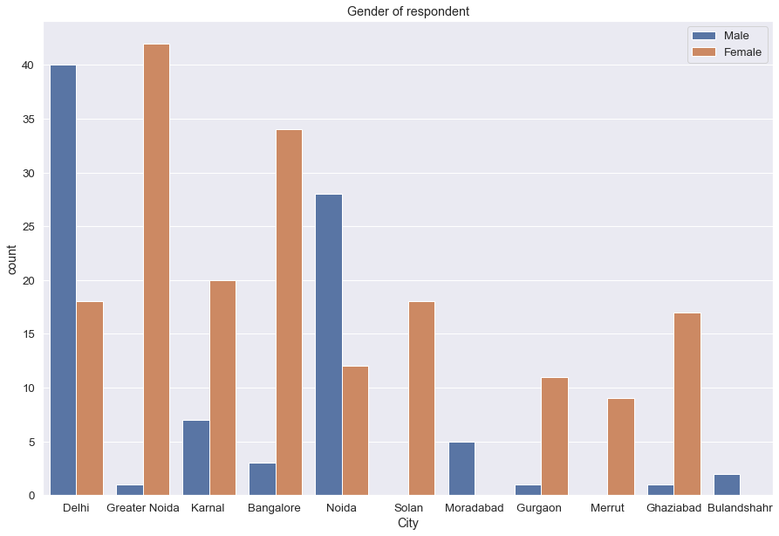
Observation :
In the region of Gr. Noida and Bangalore, male are not taking participation in online store whereas in the region of Delhi and Noida Female are taking less participation in the online store. We can work on cover this difference, this might be because of some item listed on the site.
No feedback came from the solan and meerut city this is might be because of some item listed on the site.
Need to list more item on the site for male customer according to city as mentioned

Slide 22
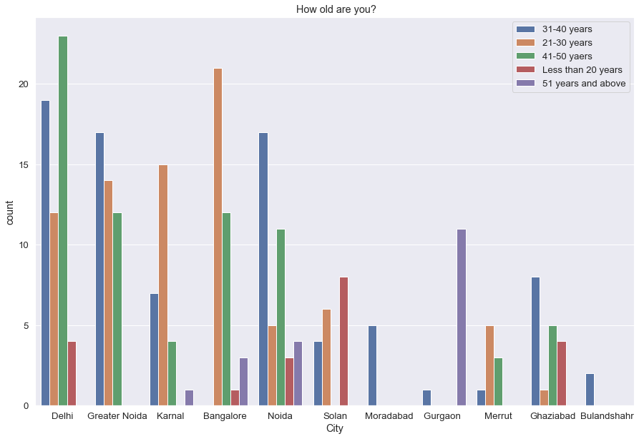
Observation:
We can see region wise visualization, what age group people need to target in which city, for growth of online store
In the region of Moradabad and Bulandshahr, almost every age group people need to target

Slide 23
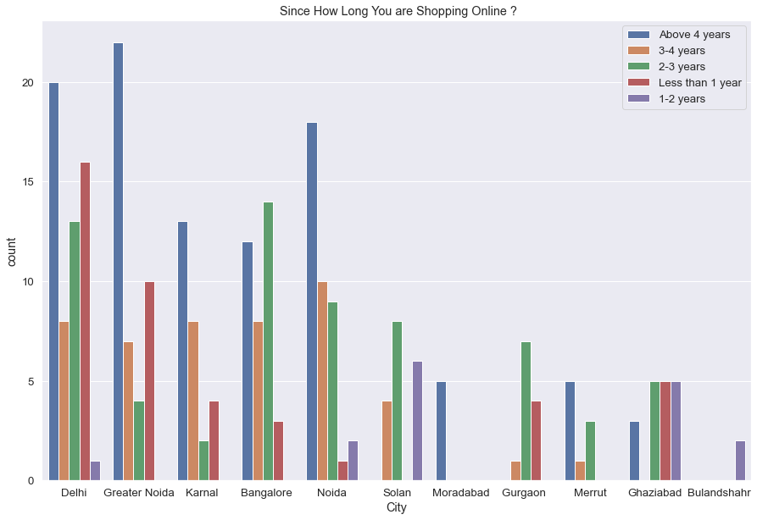
Observation:
# Moradabad and Bulandshahr are those cities where online shopping is newly established
# Less than one year count count is nill in city of solan city, moradabad, merrut, bulandshahr
# As we can observed new joiner count in above metioned cities, are zero therefore we can conclude that
# we need to apply marketing in these city to get response from the new joiner
# Noida city is also almost nill in view of new customers

Slide 24
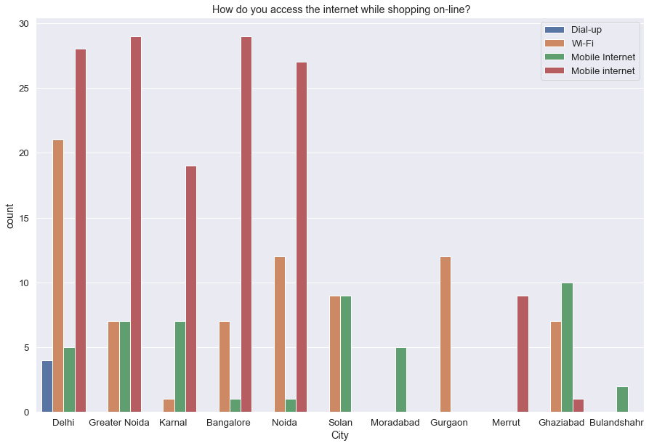
Observation:
By seeing this graph we can easily observe that in which city what resource is lacking to online shopping

Slide 25
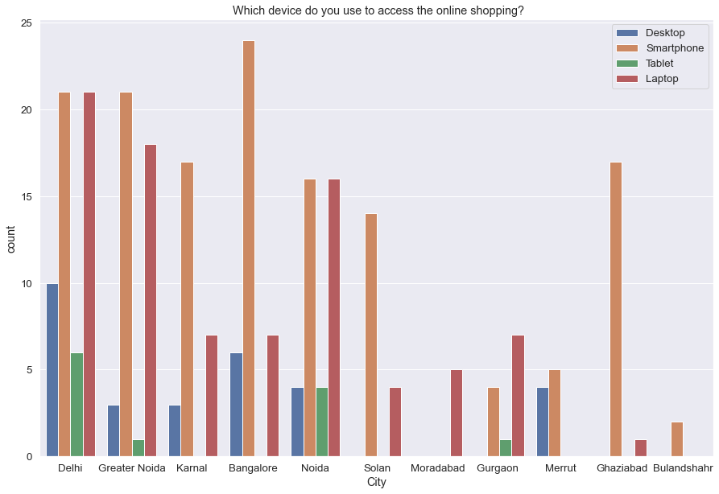
Observation:
By seeing this graph we can easily observe that in which city what resource is lacking for online shopping
As in Bulandshahr, no one is using Laptop , tablet or desktop. Only mobile is single source to access the online store there, thus this might be because of lacking of technical knowledge

Slide 26
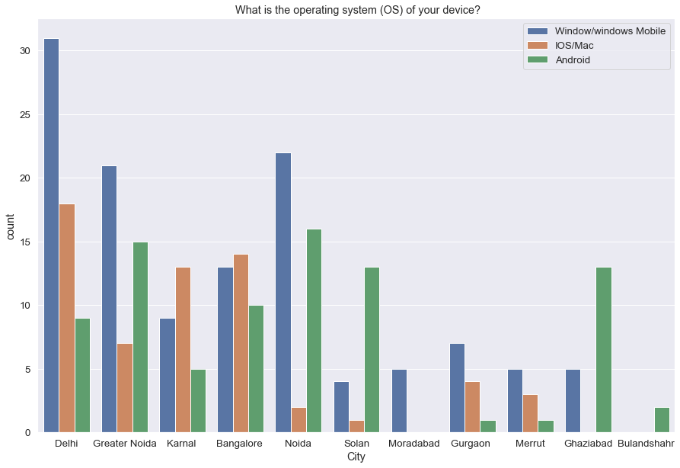
Observation:
Easily able to see which city is using what OS for online shopping, accordingly developer can provide best interface or service experience as per their city OS using record.

Slide 27
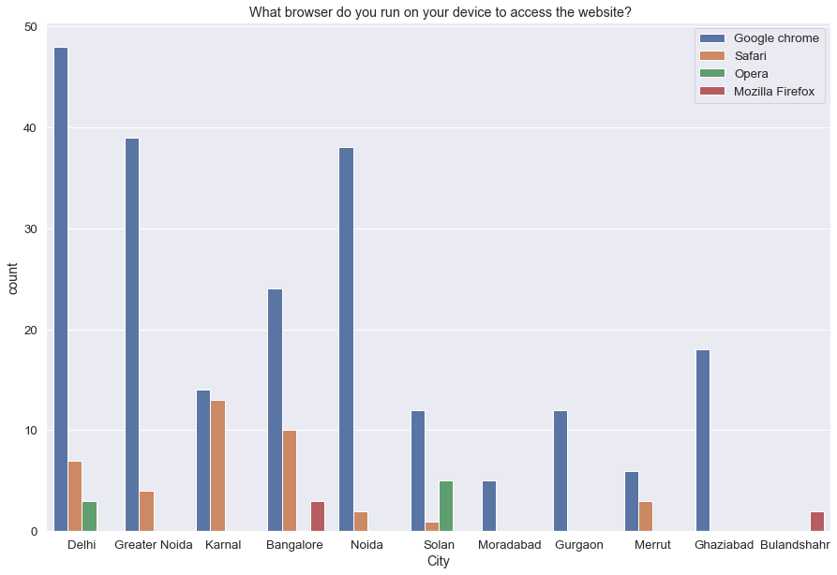
Observation:
Only two cities Banglore and Baulandshahr are using Mozilla Firbox
Maximum cities like to using Google chrome for accessing online store

Slide 28
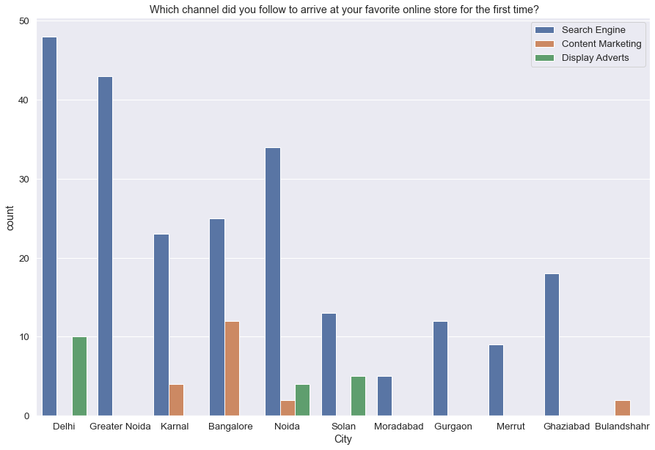
Observation:
One can easily find which marketing technique need to apply in which city to growth online shopping as per their record showed below

Slide 29
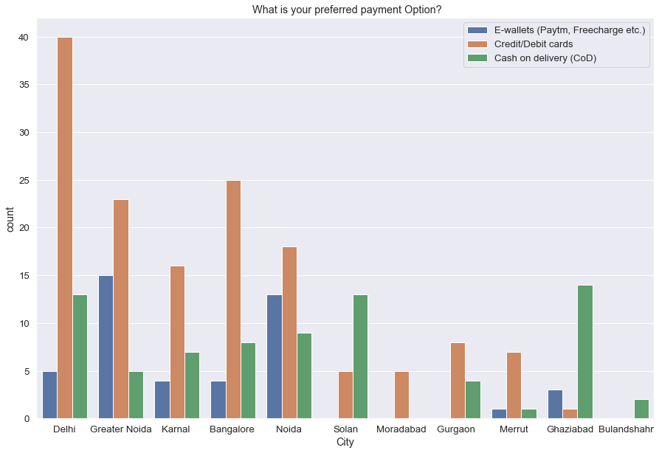
Observation:
One can see which city is like to use what payment method, according can provide best service experience of payment

Slide 30
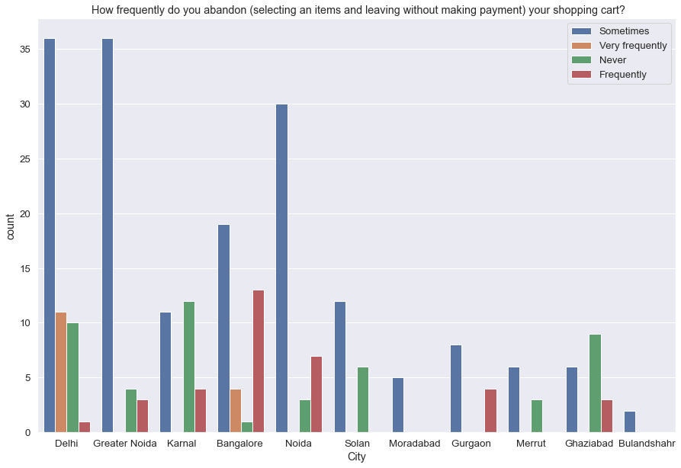
Observation:
1. Only and delhi and banglore people are abandoning the shopping cart very frequently, may be these region are facing some issue.

Slide 31
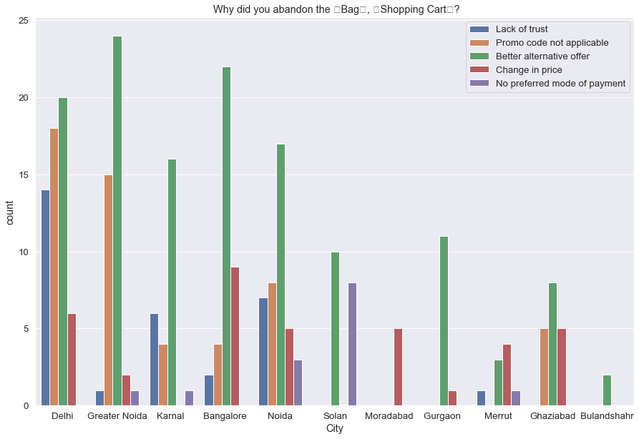
Observation:
1. Can find city wise issue which is leading of abandon the product,
2. Accordingly solution can be provided to respective cities

Slide 32
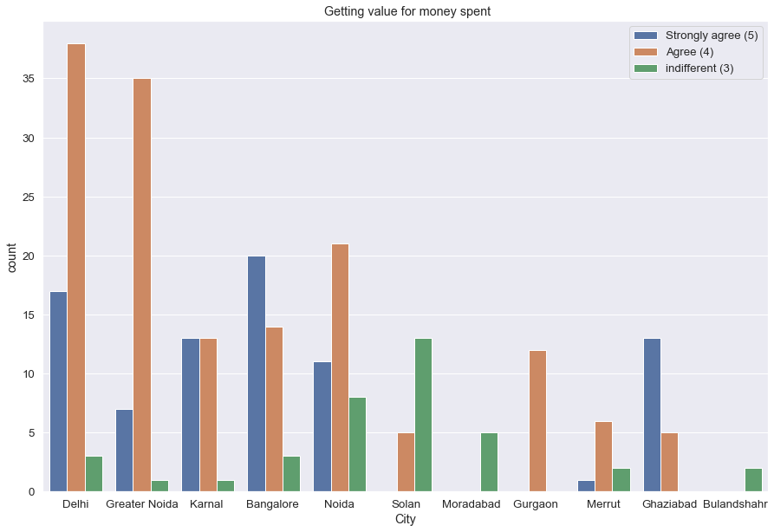
Observation:
Moradabad and Bullandshehr people are not thinking that online store is value for value
Need to provide best services there, which can be leads to change their mind set toward online store

Slide 33
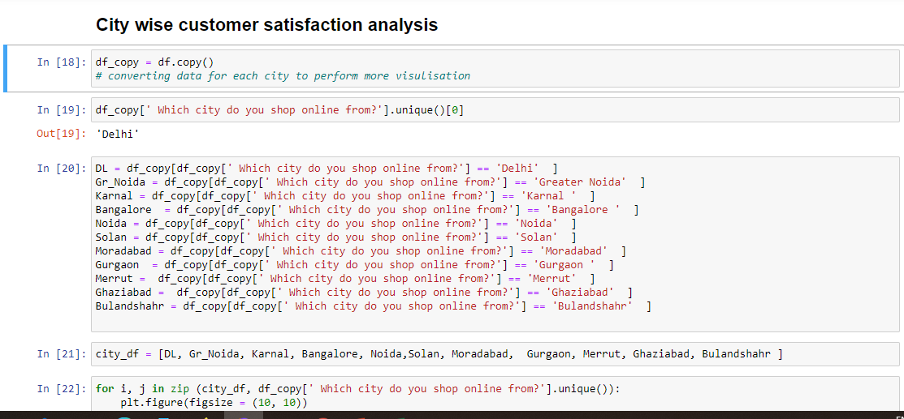

Slide 34
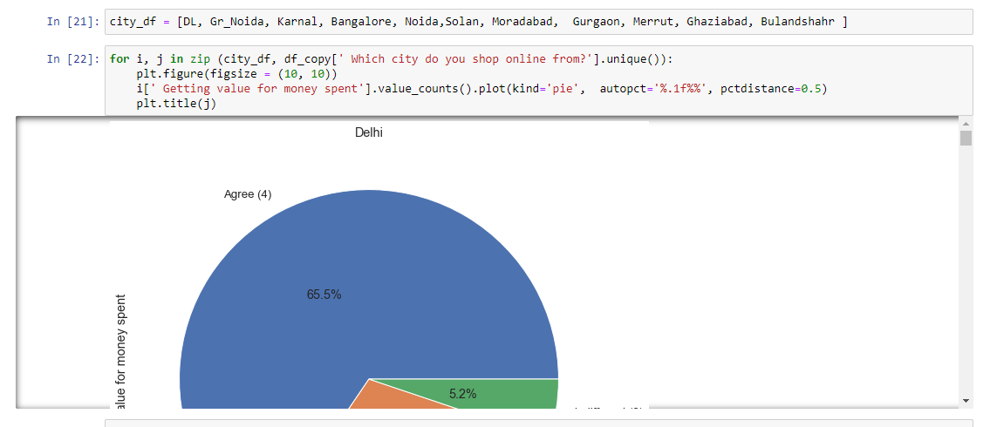

Slide 35
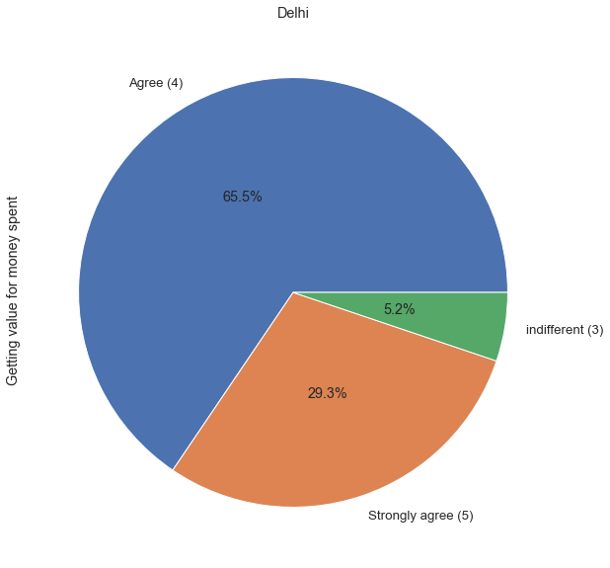
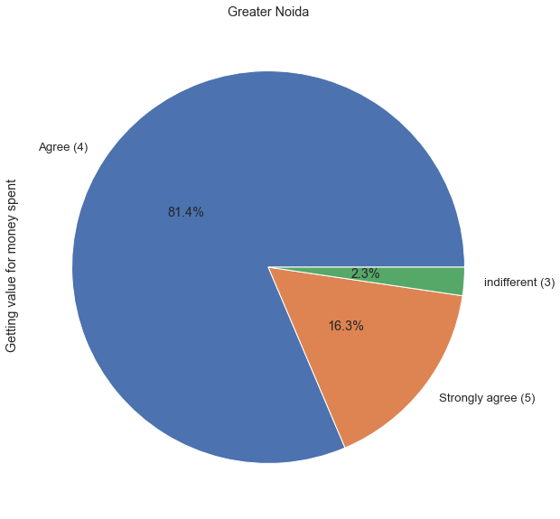
City wise Satisfaction Percentage based on customer feedback

Slide 36
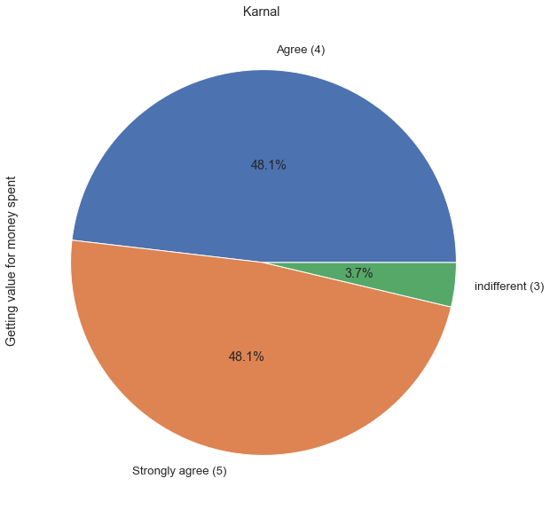
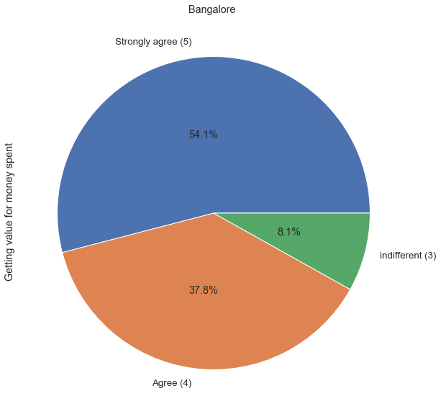
City wise Satisfaction Percentage based on customer feedback

Slide 37
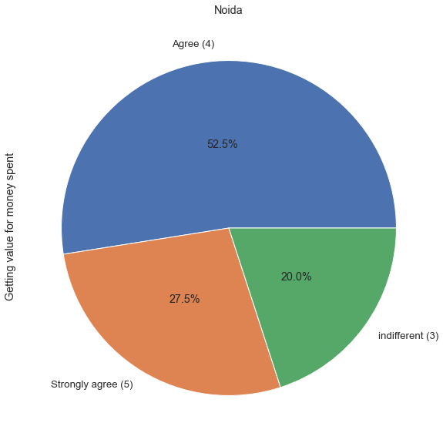
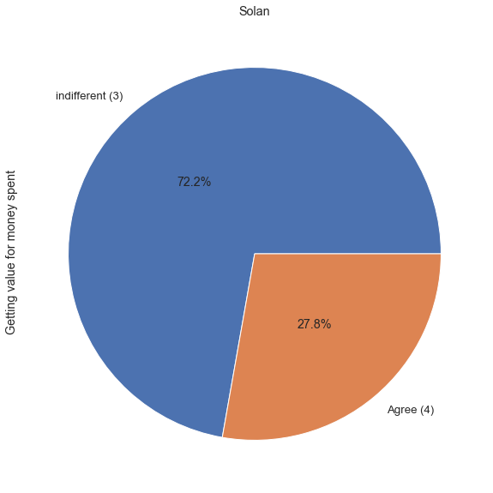
City wise Satisfaction Percentage based on customer feedback

Slide 38


City wise Satisfaction Percentage based on customer feedback

Slide 39


City wise Satisfaction Percentage based on customer feedback

Slide 40

City wise Satisfaction Percentage based on customer feedback

Slide 41


Slide 42


Age Group Wise Satisfaction Percentage Analysis

Slide 43


Age Group Wise Satisfaction Percentage based on customer feedback

Slide 44

Age Group Wise Satisfaction Percentage based on customer feedback

Slide 45


Slide 46

Majority of peoples belonging to 31-40 years age group, who are shopping regularly. We need to look other age group too
Who is in the age of 51 years and above, they are not shopping regularly, only few of them are doing
As per above graph every group people are doing shopping Less than 10 times

Slide 47

Maximum people are using Window/Window mobile to access the online store
Very less people are using IOS/Mac to access the online store

Slide 48

Google Chrome browser is on top in usage. Whereas Mozila and Opera are used by few people only
Mozila is used by only two age group people , 31-40 years and 21-30 year age group people

Slide 49

Search engine is giving best result to attract customers of all age group for the first time
Content marketing and Display Advertis are equally contributing to attract new customer

Slide 50

After first time interaction, customers mainly reaching site Via application , Search Egnine and directly url
But Age group of > 50 are not reaching site through application
Social media is only few peoples who are in age group of 21-30 years and 41-50 yeras

Slide 51

Less than 20 year age group people are taking only 1-5 min to make decision
Maximum number of people from each age group are taking more than 15 mins time to make decision except less than 20 years age group people

Slide 52

Majority is using Credit/Debit card payment option
We can point out that 51 years and above age group people are not using E-wallet payment method

Slide 53

If we see people who are very frequently abandon, then we found 41-50 years age group people are abandoning cart very frequently as compare to other age groups
All age group people have abandon shopping cart sometimes

Slide 54

Main Region for abandon is Better Alternative offer
Secondly, promo code not applicable
Lack of trust
One can work on it and fix to overcome this problems

Slide 55

People who are shopping online from last 1-2 years are not shopping regularly as found in above graph
Maximum people have shopping online only less than 10 times

Slide 56
Different –different services survey with different -different age group people graph created in the Jupyter notebook

Slide 57


Slide 58


Service Analysis of overall Population feedback

Slide 59


Service Analysis of overall Population feedback

Slide 60


Service Analysis of overall Population feedback

Slide 61


Service Analysis of overall Population feedback

Slide 62


Service Analysis of overall Population feedback

Slide 63


Service Analysis of overall Population feedback

Slide 64


Service Analysis of overall Population feedback

Slide 65


Service Analysis of overall Population feedback

Slide 66


Service Analysis of overall Population feedback

Slide 67


Service Analysis of overall Population feedback

Slide 68


Service Analysis of overall Population feedback

Slide 69


Service Analysis of overall Population feedback

Slide 70


Service Analysis of overall Population feedback

Slide 71


Service Analysis of overall Population feedback

Slide 72

Service Analysis of overall Population feedback

Slide 73


Slide 74


Slide 75


Slide 76


Slide 77


Website feedback for online shopping

Slide 78


Website feedback for online shopping

Slide 79


Website feedback for online shopping

Slide 80


Website feedback for online shopping

Slide 81


Website feedback for online shopping

Slide 82


Website feedback for online shopping

Slide 83


Website feedback for online shopping

Slide 84


Website feedback for online shopping

Slide 85


Website feedback for online shopping

Slide 86


Website feedback for online shopping

Slide 87


Website feedback for online shopping

Slide 88


Website feedback for online shopping

Slide 89


Website feedback for online shopping

Slide 90


Website feedback for online shopping

Slide 91


Website feedback for online shopping

Slide 92


Website feedback for online shopping

Slide 93


Website feedback for online shopping

Slide 94


Website feedback for online shopping

Slide 95


Website feedback for online shopping

Slide 96


Website feedback for online shopping

Slide 97


Website feedback for online shopping

Slide 98


Website feedback for online shopping

Slide 99


Website feedback for online shopping

Slide 100


Website feedback for online shopping

Slide 101
Website feedback for online shopping

